Slide 1
General Land Office
How to complete your HUB Subcontracting Plan (HSP)

Slide 2
HUB SUBCONTRACTING PLAN (HSP) IS A REQUIREMENT
Once the agency determines that HUB subcontracting opportunities are probable in the Scope of Work, a completed HUB Subcontracting Plan must be returned with your Bid/Proposal.
If the HSP is not submitted with your response or fails to meet good faith effort requirements, your response will not proceed to the evaluation team.

Slide 3
HUB SUBCONRACTING PLAN (HSP)
Read the HUB Subcontracting Plan (HSP) form before you begin.
The HUB GOAL is identified in the “Special Instruction” section of the HSP.
Decide whether or not you will need to subcontract parts of the contract in order to complete the agency’s scope of work.
Read the four different options on the HUB Subcontracting Plan (HSP) checklist and determine which options fit your response. Answer each section within that option.
Note: HSP Good Faith Effort – Method B (Attachment B) will require you to provide a Good Faith Effort notification and contact HUBs, trade organization or development centers.

Slide 4
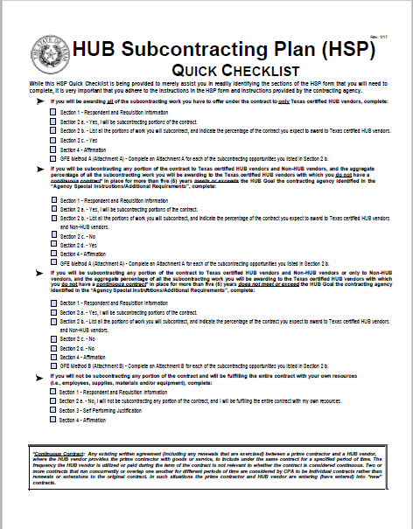
HUB Subcontracting Plan (HSP) Quick Checklist
There are four ways to complete the HSP based on the checklist.
The checklist identifies which sections of the HSP to complete based on your subcontracting intentions.

Slide 5
You may select one of the four options to complete the scope of work…
Options #1 – You are using subcontractors and they are all Texas Certified HUBs.
Option #2 – You will meet or exceed the HUB goal using Texas certified HUBs and Non-HUB subcontractors.
Option #3 – You will not meet the stated HUB goal using Texas Certified HUBs and Non-HUB subcontractors.
Option #4 – You will self-perform the entire contract with your own resources. (own employees, supplies, materials and/or equipment, to include transportation and delivery)

Slide 6
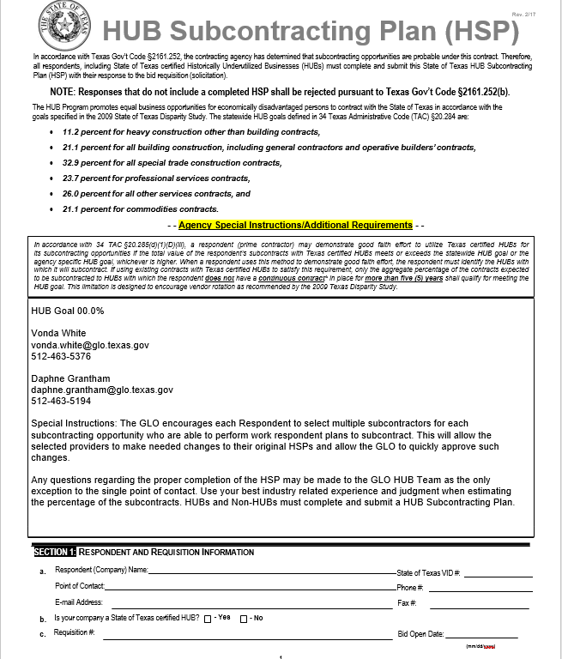
HSP Information Page:
Page 1
HUB GOALS
Special reminders and instructions
Respondent and requisition
information

Slide 7
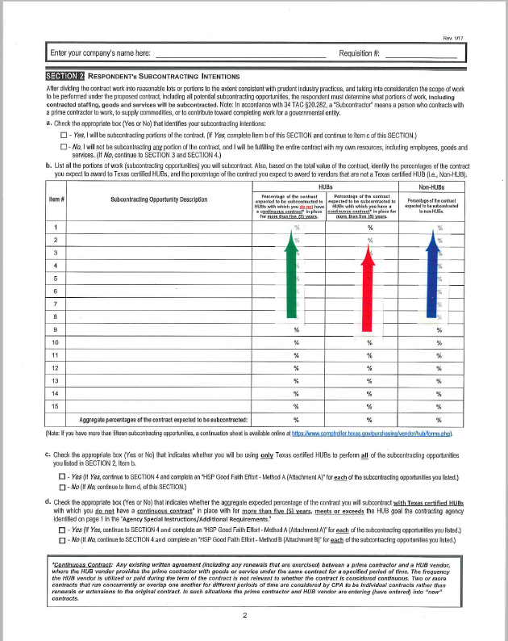
Company Name and Requisition #
Page 2
Section 2:
Subcontracting Intentions:
Section – 2, item (a)
Section – 2, item (b):
List portions of work (subcontracting
opportunities) you will subcontract,
and identify the percentages of the
contract you expect to award to all HUBs
and Non-HUBs vendors.
If you will be using Texas certified HUBs, with whom you have had a continuous contract in place for more than (5) years, you may use them, they just won’t count towards your HUB goal.

Slide 8
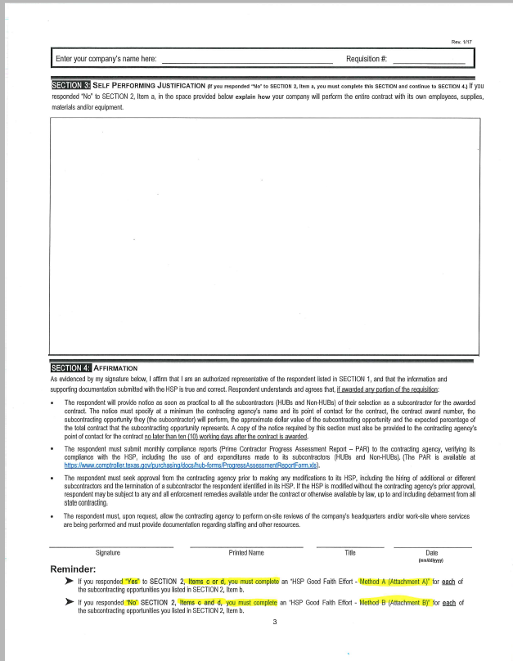
Section 3: Self Performance Justification
Page 3
Give a complete and thorough explanation of how your company will perform the entire contract with its own resources.
Section 4:
Affirmation
Signature affirms that information provided is true and correct.
Note: After award, the HSP becomes part of your contract deliverables.

Slide 9
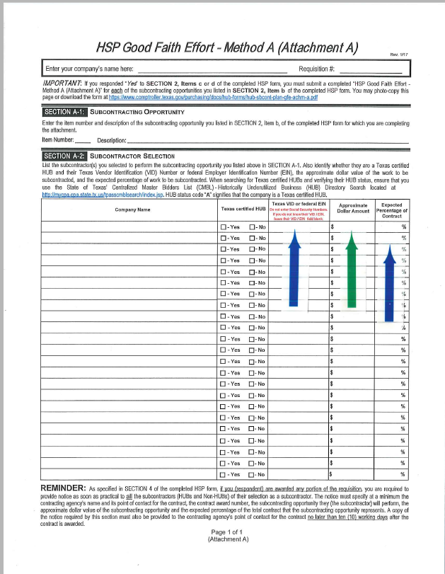
HSP GFE Method A (Attachment A)
Page 1 of 1
Section A-1
If you responded “Yes” to Sections 2, Items
(c) or (d), you must submit a completed
“HSP Good Faith Effort – Method A
(Attachment A)” for each of the
subcontracting opportunities listed in Section-2,
item (b).
Note: Item number must coincide with “Section-2, item (b).
Section A-2
Identify subcontractors that will be used
during the course of the contract; please list
VID number for HUBs and Non-HUBs;
approximate dollar amount and percentage
of work to be subcontracted.
To Be Determined is not acceptable.
Percentage should coincide with Section-2, item (b).

Slide 10
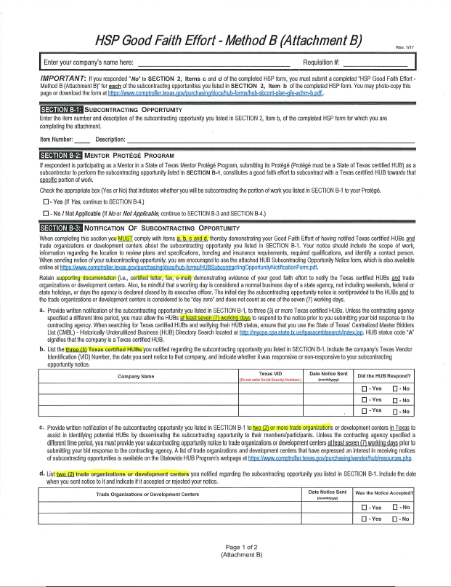
HSP GFE Method B (Attachment B) : If you responded “No” to section-2, items (c) and (d), you must submit a completed “HSP Good Faith Effort – Method B (Attachment B)” for each of the subcontracting opportunities listed in Section-2, item (b).
Page 1 of 2 (Attachment B)
Section B-2: Use only for HUB Protégé subcontracting opportunity.
Section B-3:
Notification of subcontracting
opportunity.
Note: You must comply with all items in Section B-3: A, B, C and D.

Slide 11
Notification of a Subcontracting Opportunity 7 Working Day Notification
Notify at least (3) Texas certified HUBs businesses of the subcontracting opportunities that respondent intends to subcontract.
Notify (2) or more trade organizations or development centers.
You must allow the HUBs, trade organization, and development centers at least (7) working days to respond to your notification prior to submitting your bid response to the agency (during the solicitation posting period).
The initial day of notification is considered “day zero” and does not count as one of the (7) working days.
Does not include weekends, federal or state holidays, or days the agency is closed by the executive director.
You must provide written notification of each subcontracting opportunity listed in Method B; Section B-1.Please retain supporting documentation (certified letters, faxes and e-mails) and submit them with your HSP.

Slide 12
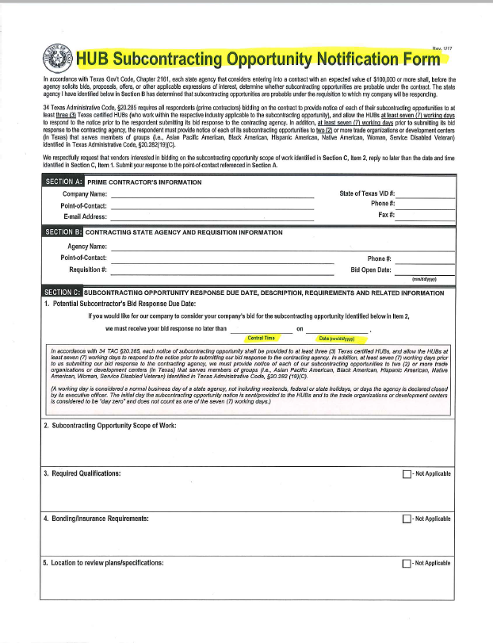
HUB Subcontractor Notification form:
Note: Respondent must provide notice of each subcontracting opportunity.

Slide 13
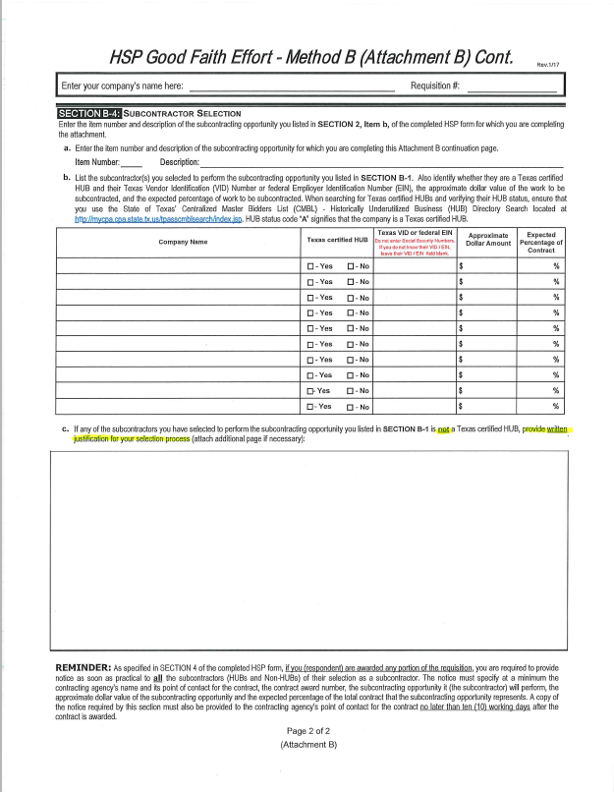
HSP GFE Method B (Attachment B)
Page 2 of 2 (Attachment B)
Enter information for HUB Protégé subcontracting opportunity.
or
List subcontractors you selected to perform the opportunity you listed in Section B-1.
If any of the subcontractors you selected to perform the opportunity listed in Section B-1 is not a Texas certified HUB, provide written justification for your selection process.

Slide 14
Affirmation
Respondent understands and agrees that if awarded any portion of the requisition:
The respondents are required to provide written notice to all subcontractors (HUBs and Non-Hub) of their selection as a subcontractor for the awarded contract. A copy of this notice must be provided to the contracting agency’s point of contact no later than (10) working days after the contract is awarded.
The respondent must submit monthly expenditure reports (Prime Contractor Process Assessment Report – PAR), as a condition of payment and to verify their compliance with the HSP.
The respondent must seek approval from the agency prior to making any modifications to the HSP. A HUB Subcontracting Plan (HSP) Change Order form will be provided by the agency.

Slide 15
HSP Evaluation Process
The agency will review and evaluate the HSP and supporting documentation.
The agency may request clarifications or further documentation of your good faith effort.
The HSP is not evaluated on a point system. Instead, it is reviewed for compliance with good faith effort requirements.

Slide 16
HSP Resources
Texas Comptroller of Public Accounts website HUB forms will guide you through the proper completion of the HUB Subcontracting Plan (HSP) form:
https://www.comptroller.texas.gov/purchasing/vendor/hub/forms.php

Slide 17
GLO HUB Team Contacts
If you have any questions concerning the HSP, please contact GLO HUB Coordinators below.
Vonda White, HUB Coordinator
Vonda.White@glo.texas.gov
512-463-5376
Daphne Grantham, Assistant HUB Coordinator
Daphne.Grantham@glo.texas.gov
512-463-5194
Stella Roland, Assistant HUB Coordinator
Stella.Roland@glo.texas.gov
512-463-7201

